Slide 1

Brain Lesion Segmentation from MRI Images
May 2020

Slide 2

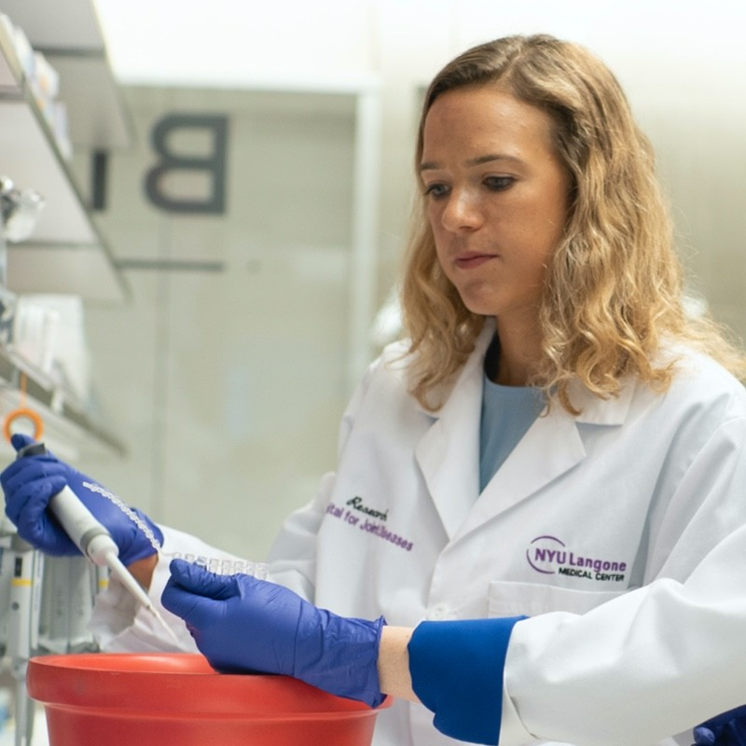

Dajr Alfred
Nitzan Segal
Barr Morgenstein
-Group 14-

Slide 3


Outline
Background
BraTS dataset
Segmentation models
Code demonstration (GitHub)
Project objective
Results

Slide 4
Project objective
In this project we aim to implement and compare segmentation models to evaluate brain MRI scans and label lesions, using T1, T1-C, T2 and FLAIR MRI scan modalities

Slide 5
Background
MRI scans are essential in the effort of diagnosing and treating brain tumors
Often, the MRI data is subject to added artifacts resulting in bias to the scans, affecting the segmentation and the diagnostic process models
Computer algorithms for brain lesion segmentation aim to isolate malignant tumorous regions from the healthy tissue, in a quick and more accurate manner, compared to the manual segmentation process, helping to provide a successful treatment

Slide 6
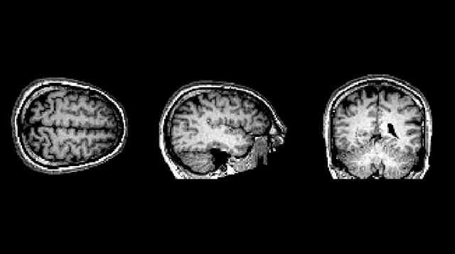

Slide 7
BraTS dataset
The brain MRI data was provided by the MICCAI BraTS Challenge database (fully anonymized images from the Cancer Imaging Archive). Images are in a *.mha format
The dataset consists of approximately 220 high-grade glioma cases and 54 low-grade cases. Each case includes T1, T1C, T2, Flair. Train cases additionally include ground truth labels
The segmentation is aimed to label the cases by: 1 necrosis 2 edema 3 non-enhancing tumor 4 enhancing tumor 0 else (Colour Code-> black0, else red:1, necrosis blue:2, edema pink:3 , non-enhancing tumor white :4,enhancing tumor)
Notes:
T1, T1 contrast enhanced (T1C), T2, Flair are 4 modalities of brain MRI volumes

Slide 8
BraTS dataset
Each patient’s MRI produces around 600 images → The four sequences produce 155 slices each
The preprocessing stage is designed to transform scans of same slice into strip of all the images
The models are trained on randomly selected 33x33 patches (slices) of MRI strip images
The input is of 4 channels, one for each imaging sequence. The output has 5 channels, for each of the labels

Slide 9
Segmentation models
In this project we explored the models:
U-Net architecture, a 4 layers model as learned in class (CA04)
CE-Net, relying on a novel dense atrous convolution (DAC) block and a residual multi-kernel pooling (RMP) block
Fully-convolutional network (FCN) with 6 convolutional, normalizing+ ReLu layers followed by convolution – designed specifically for 2D medical imaging segmentation
*Each model was tested for its efficiency on a validation dataset

Slide 10

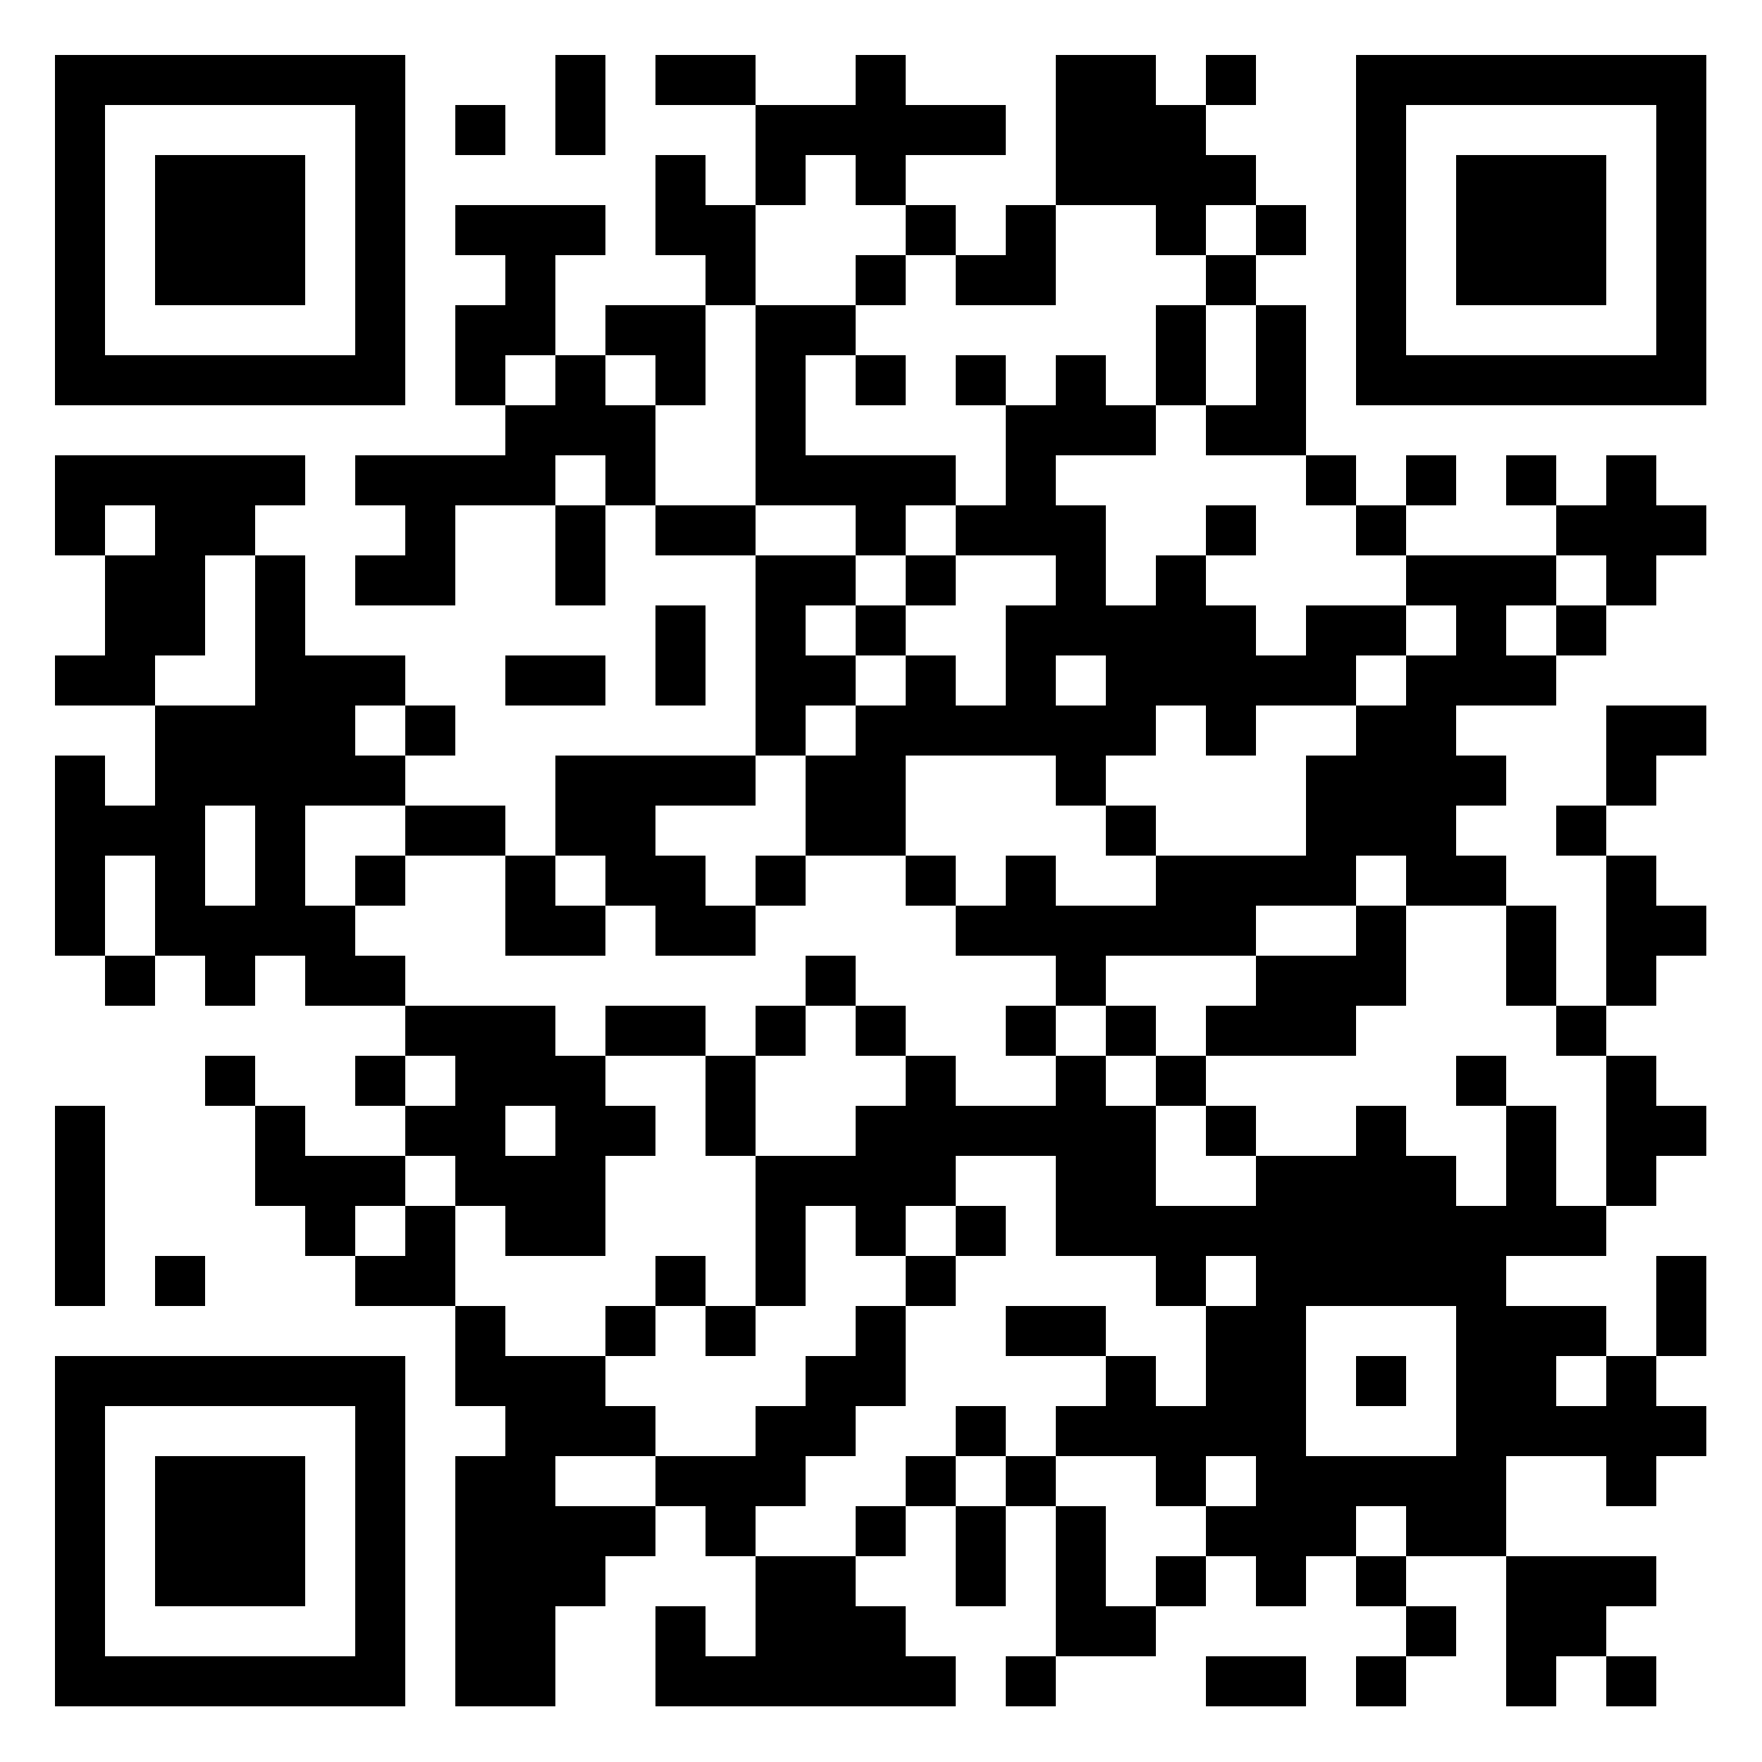
Code demonstration (GitHub)

Slide 11
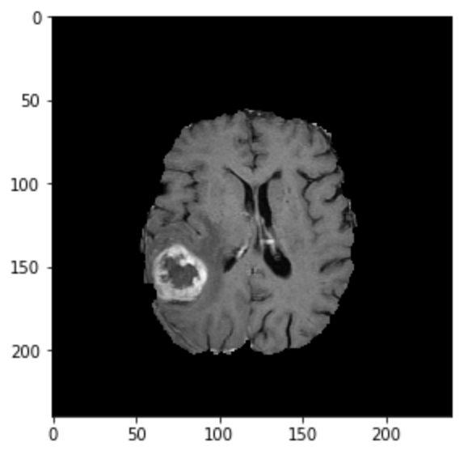
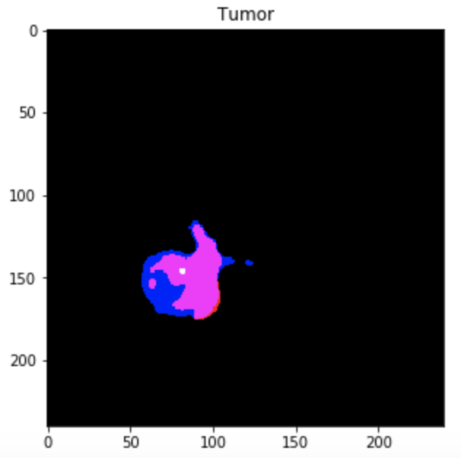
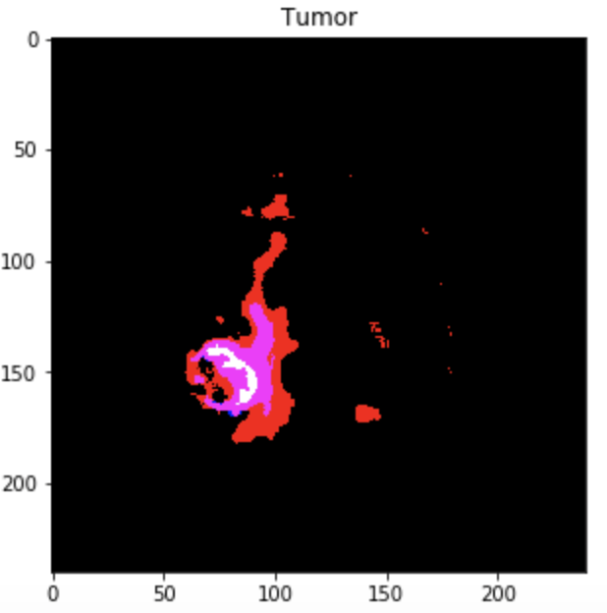
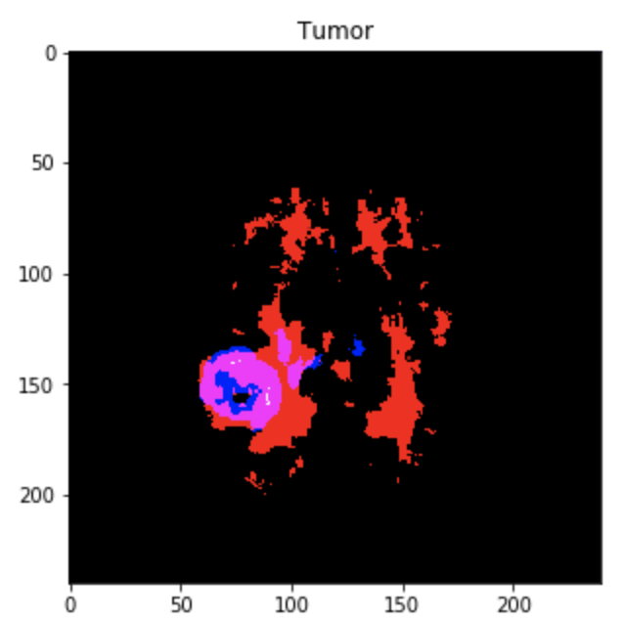
Results
CE-Net
U-Net
FCN

Slide 12
Results
 | CE-Net | U-Net | FCN
Validation Cross-Entropy Coeff | 0.6017 | 0.500 | 0.519
Loss | 0.310 | 0.513 | 0.473

Slide 13
Results
By observation on samples of the segmentation models output and according to the loss values presented, the CE-Net is most accurately localized on the lesion area. The FCN is the least accurate, giving a high rate of false positive indications in the area surrounding the brain lesion
The Validation Cross-Entropy Coefficients, however, indicate that the U-Net performed better in terms of labelling accuracy. This was followed by the FCN and finally the CE-Net having the worst labelling accuracy. (May be due to overfitting and/or unsuitable loss function and/or unsuitable model structure and/or unsuitable training-set

Slide 14
Results
Suggestions for future analysis
Exploiting general symmetry of the brain:
Feature-based lesion detection
Detecting feature points on the left and right sides of the brain
Map the points using mirror transform
Tumor will show up as an outlier

Slide 15
References
Havaei, M., Davy, A., Warde-Farley, D., Biard, A., Courville, A., Bengio, Y., ... & Larochelle, H. (2017). Brain tumor segmentation with deep neural networks. Medical image analysis, 35, 18-31
Menze, B. H., Jakab, A., Bauer, S., Kalpathy-Cramer, J., Farahani, K., Kirby, J., ... & Lanczi, L. (2014). The multimodal brain tumor image segmentation benchmark (BRATS). IEEE transactions on medical imaging, 34(10), 1993-2024
Ronneberger, O., Fischer, P., & Brox, T. (2015, October). U-net: Convolutional networks for biomedical image segmentation. In International Conference on Medical image computing and computer-assisted intervention (pp. 234-241). Springer, Cham
Gu, Z., Cheng, J., Fu, H., Zhou, K., Hao, H., Zhao, Y., ... & Liu, J. (2019). CE-Net: context encoder network for 2D medical image segmentation. IEEE transactions on medical imaging, 38(10), 2281-2292

Slide 16
Thank You!

